Slide 1


SAP Group Reporting Training
Naveen

Slide 2



The training content and delivery of this presentation is confidential, and cannot be recorded, copied, or distributed to any third party, without the written consent of Anubhav Trainings.

Slide 3



INTRODUCTION

Slide 4



SERVER

Slide 5

DAY 1: Overview of Group Reporting
Overview of GR
Key terms, Features, and Architecture
Describing the structures

Slide 6
Key Milestones After The Evolution OF Hana
2011
Hana
Real-Time Analysis
Real-Time Reporting
2012
BW on Hana
Real-Time Business
OLAP AND OLTP Together
SAP HEC for SAP
Business Suite on SAP Hana
2013
SAP Business Suite on Hana
Instant Financial Insight
No Aggregation
Single Source of Truth
2014
SAP Simple Finance
Simplified Data Model
Logistic Reinvented
New Code Line
New User Experience
2015
SAP S/4 Hana

Slide 7
Group Reporting
Group Reporting is the latest innovation by SAP in the S/4HANA space with an 1809 release.
We are all aware of the below consolidation products by SAP :
Enterprise Controlling Consolidation System (EC-CS) was part of SAP R/3. It offers real-time integration with the general ledger, which can be activated at the consolidation unit level by selecting the Realtime update from FI data transfer. The end of maintenance of EC-CS is planned for December 31, 2025
Strategic Enterprise Management’s Business Consolidation (SAP SEM-BCS). It is based on the SAP Business Warehouse (SAP BW) platform. SAP Financial Consolidation – SAP Financial Consolidation, formerly known as SAP BusinessObjects Financial Consolidation. It supports both legal as well as managerial consolidations and can also be used for planning and consolidation.
SAP Business Planning and Consolidation – Most of the customers use this presently. It is available in several versions, including SAP BPC for SAP S/4HANA. It will be supported as long as the SAP S/4HANA on-premise version to which it’s tagged but no major developments are expected.

Slide 8
SAP S/4HANA Group Reporting
ACDOCU
ACDOCA
ACDOCP
Actual Data For S/4 HANA Companies
Plan Data

Slide 9
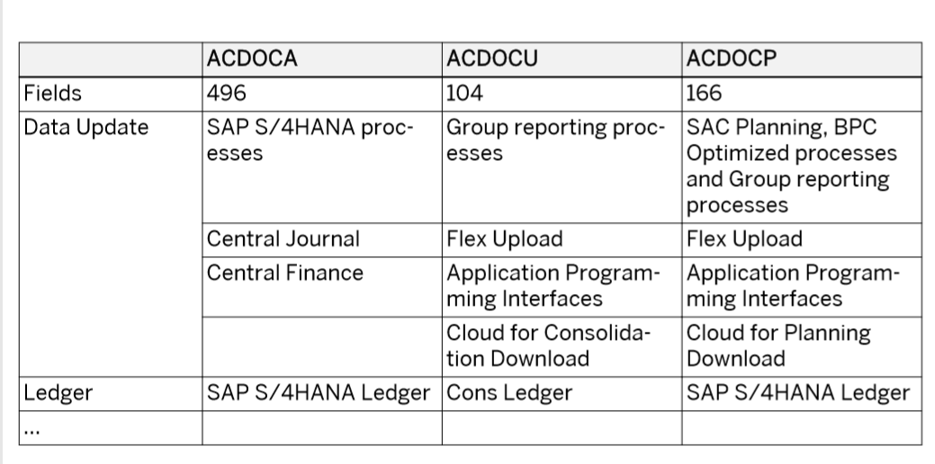

Slide 10
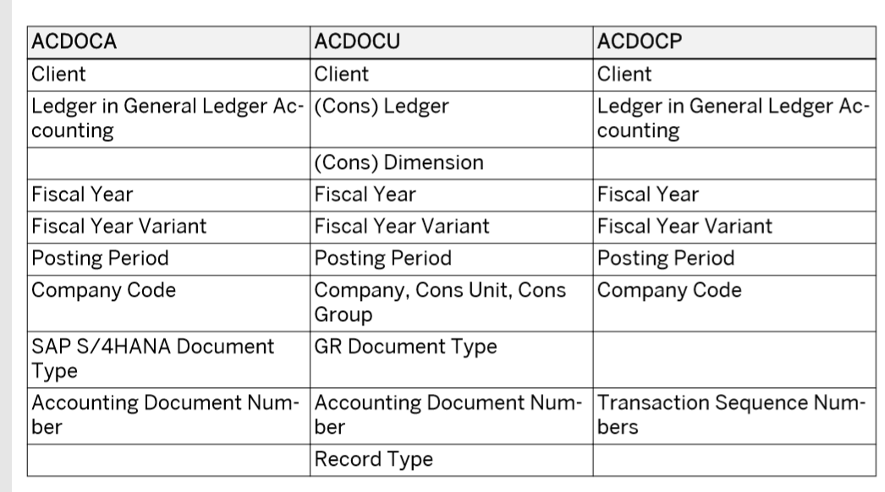

Slide 11
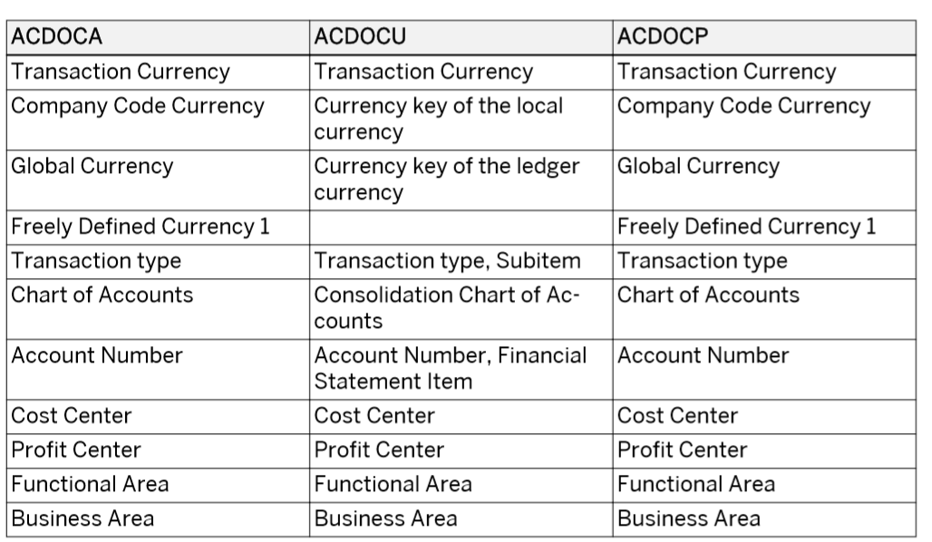

Slide 12
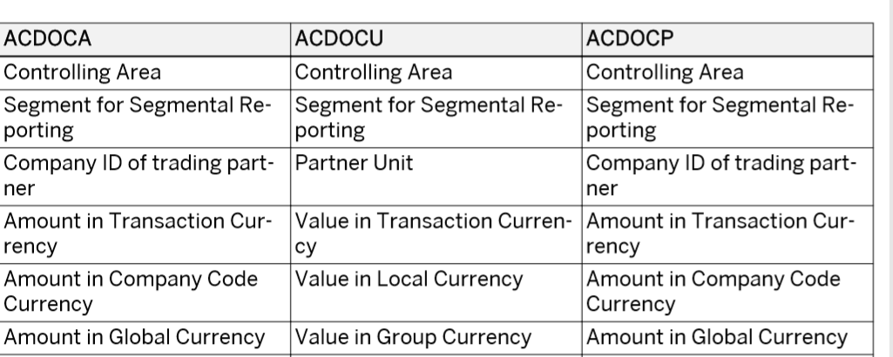

Slide 13



We’re committed to empower you to be
#FutureReady
through powerful training solutions.
We build the workforce of the future.
250+
Corporate Clients
30,000+
Learners Trained
25000+
Learners Placed
FREE WEBINARS
Sign up for free webinars with industry experts every fortnight!
Enroll Now!
Contact us today!
www.anubhavtrainings.com

